Slide 1

Before We Begin...
All links can be found on: https://github.com/UWB-ACM/git-gud-workshop-spring-2019
Install Git (command line)
https://git-scm.com/downloads
Create a GitHub account if you don’t have one already.
Use a private email (not your school email)
https://github.com/
Comment in the following issue to get added as a contributor to today’s example repository
https://github.com/UWB-ACM/FancyCalculator/issues/60
Notes:
Should show this as people get into the room.

Slide 2
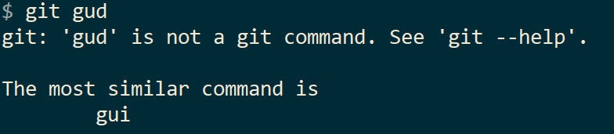
Git Gud
Workshop
Presenters: Alan Gonzalez
By your friends at
UWB ACM
Notes:
Welcome everyone

Slide 3
Git Gud
Let’s review old concepts

Slide 4
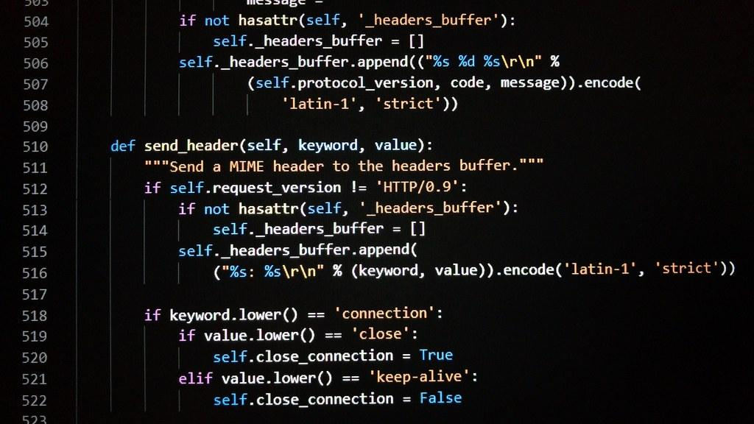

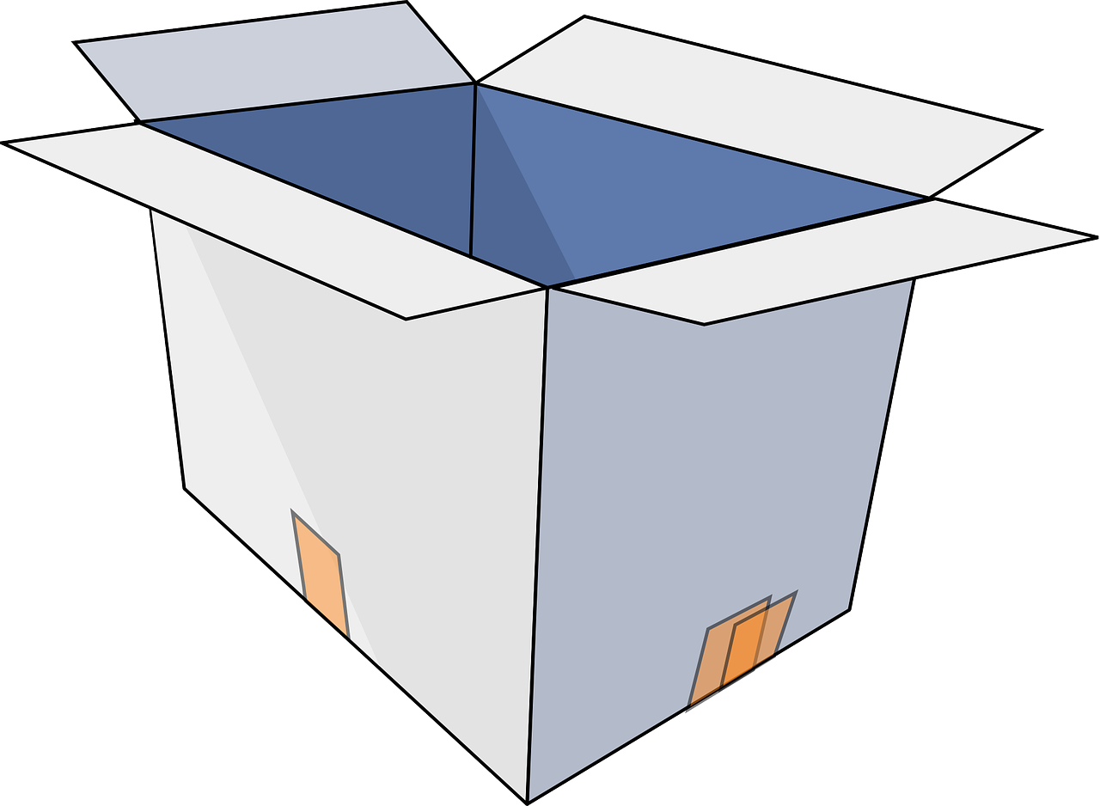
How Git Works - Overview
Step 1 - Code
Step 2 - Stage
Step 3 - Commit
Code on your local computer.
Choose which file changes you want to save.
Save your changes to your code in a commit.
We’ll go into more detail in the workshops
Notes:
30 per slide in the recap

Slide 5

Vocabulary: Repo
Code
Commit
Upload
Repo / Repository
A directory tree which is named .git.
The repository contains a representation of the contents of a directory tree, or project, on your computer.
Git tracks changes to files in your project, and stores the revision history of the project in the repository folder.

Slide 6
Vocabulary: Commit
Code
Commit
Upload
Commit
A set of changes applied to files which is permanently saved to the repository history.
A commit is always linked to one or more previous commits (called parents), creating a chain of revisions.
Commits also have authors and messages associated with them, detailing who created the changes and why.
Commits are uniquely identified using a SHA256 hash.

Slide 7
Vocabulary: More Goodies
Code
Commit
Upload
Status
The current state of your repository. It has lots of great information. If (or when) you feel lost, run git status to see what’s up with your project.
Staging
Staging changes in git ensures those changes will be included in your next commit.
Typically, this is done through the git add command.
The staged changes will be in your staging area until you commit them or remove them from the staging area.

Slide 8

How Remote Syncing Works - Overview
Step 1 - Pull
Step 2 - Commit
Step 3 - Push
Download (aka pull) new changes and update your local copy of the repository.
Upload (aka push) your commit(s) to the server.
Now others can view the code with your changes included.
Make changes and save your changes in a commit.
We’ll go into more detail on the next slides

Slide 9
Vocabulary
Code
Commit
Upload
Remote
The repository’s remote points to a remote storage endpoint which contains a copy of the current repository.
The remote has a name; a common convention is to call the remote origin.

Slide 10
Vocabulary
Code
Commit
Upload
Push
Sync local changes to the repository by uploading local commits to remote storage (GitHub, GitLab, BitBucket, SourceHut, private servers, etc.).
Pull
Retrieve changes from repository by downloading commits from remote storage.
Note: you can only run push & pull when you have a remote identified in your repository.

Slide 11
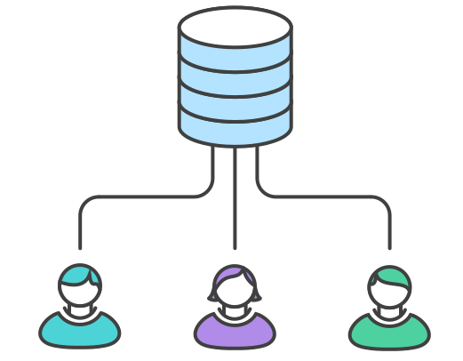


How Collaboration Works - Overview
Multiple people can collaborate on the same code easily.
Bugs, feature requests, and large projects can be tracked alongside the code.
Collaborators can easily review each other’s code to find bugs faster and build better software.

Slide 12
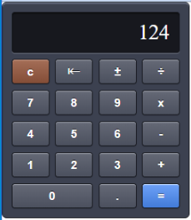
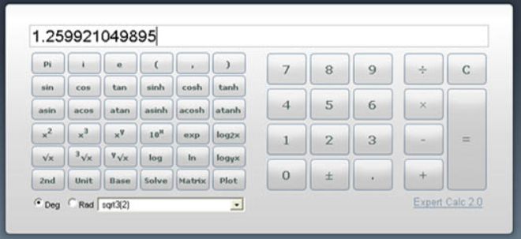
Today’s mission: build the Enterprise Calculator
We are the development team for UWB ACM Incorporated. Our company has just bought a startup: FancyCalculator. Our management has asked this team to use this as a starting point to create our new flagship product: The Enterprise Calculator.

Slide 13
Git Better
More useful things to know about git

Slide 14
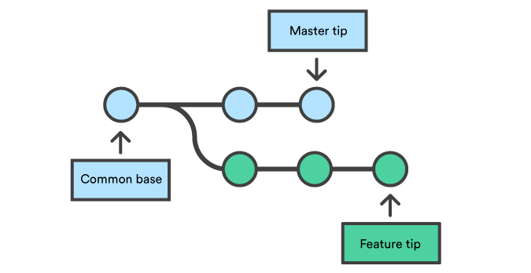
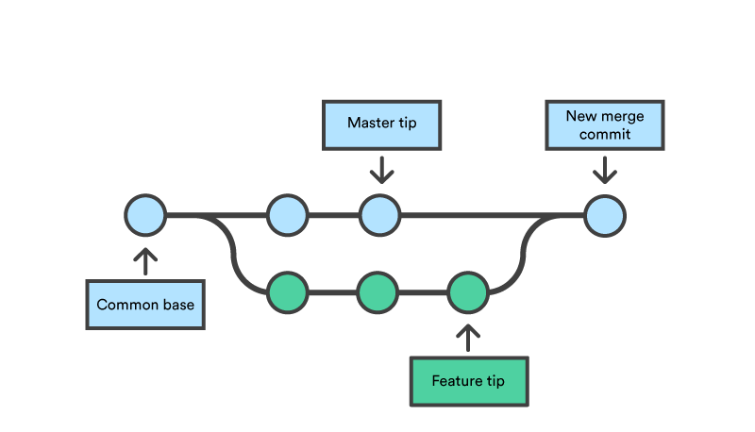
Branches
Branches keep track of changes, from a shared starting point.
Branches can:
Separate from another branch
Merge into another branch
Contain different contents from another branch

Slide 15
Using Branches
Why are branches useful?
Add new features or potentially hazardous changes to the codebase without affecting the stable version of the repository
Allow multiple developers to make changes to the same files without overwriting each others’ work
How do branches get merged together?
GitHub: pull request
GitLab: merge request
Command Line: git merge

Slide 16
Vocabulary - Cont.
Code
Commit
Upload
Branch
A branch is a human-readable label which points to a series of commits. The commit history for different branches can diverge, and users can switch between branches as needed.
Branches are used to manage parallel development efforts within projects, and allow for experimentation and prototyping without impacting “finished” code.
Merge Commit
A merge commit combines the changes from two different diverging branches back into a single branch. A merge commit has two parent commits instead of the typical single parent.

Slide 17
Vocabulary - Cont.
Code
Commit
Upload
Pull Request (aka Merge Request)
A pull request is closely related to branches, and not related to “pulling changes” at all. A pull request is a polite way of creating a merge commit.
Most remote storage providers (GitHub, GitLab, etc) provide a browser-based solution of creating merge commits, and facilitating code reviews in the process.
Pull requests are not a part of the git command set. It is an invention of remote storage providers.

Slide 18
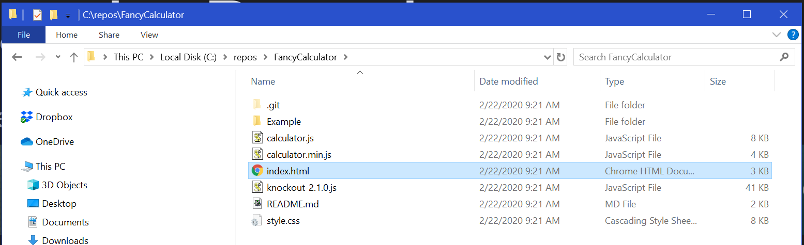
Commands: Branches
Clone the repo:
Inspect the contents of the cloned repo:
Notes:
Commands in this slide:
git clone https://github.com/UWB-ACM/FancyCalculator.git

Slide 19
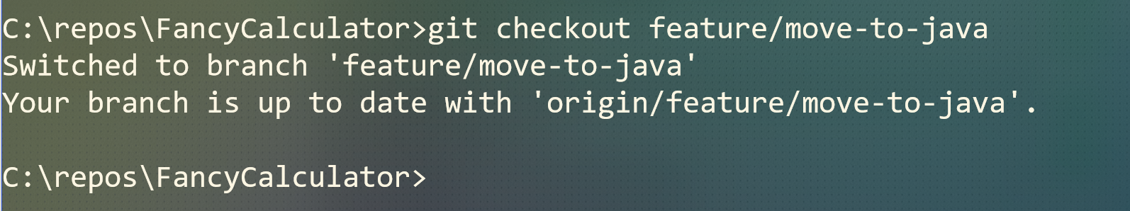
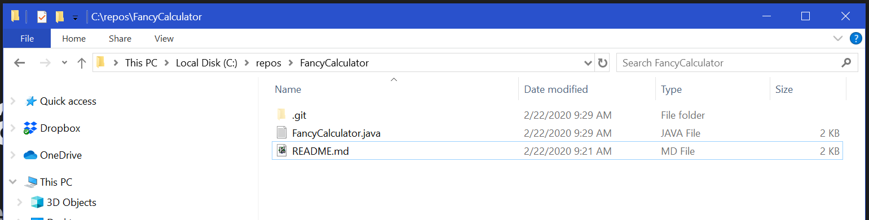
Commands: Branches
Checkout the feature/move-to-java branch:
Inspect the contents of the cloned repo, the files changed!
Notes:
Commands in this slide:
git checkout feature/move-to-java

Slide 20
Commands: Branches
Go back to the master branch:
Notes:
Commands in this slide:
git checkout master

Slide 21

Branches: what happened?
Commits are being added to master branch.
At some point a new branch was created: feature/move-to-java
Commits are being added to the new “feature” or “topic” branch.
Git has a reference to both HEADs of the branches so we can easily switch to them.
Notes:
Explanation of what we just witnessed: Master branch had some commits (the html calculator), then someone decided to replace everything with a Java calculator, but we don’t want to break the existing html calculator just yet, the java calculator is an experiment. The developer created a new branch “feature/move-to-java” and started working there without worrying that the other developers would be affected. The java developer started adding more commits onto the “feature/move-to-java” branch. When we do git checkout, git will replace all of the files in the file system with the contents of that branch. Git keeps track of the HEAD of each branch, so branches are really pointers to commits. Bonus question: what data structure does this remind you of?

Slide 22

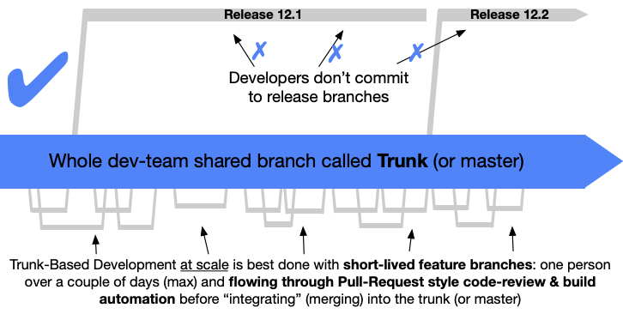
Workflows: Branching strategy or flow
gitflow single trunk
https://nvie.com/posts/a-successful-git-branching-model/
https://trunkbaseddevelopment.com/
Notes:
Branches are a powerful tool. Now we need a strategy for keeping them organized. Two very popular strategies are gitflow & single trunk (similar to github flow).
What you should know is that gitflow has many rules and tracks releases in the source control, creates a lot of overhead for small teams. The single trunk approach has a single master branch and it is easier to manage, but the price you must pay is that the quality must be high, because it will affect all of the team members and environments as soon as you merge.
We will choose single trunk for this project.

Slide 23
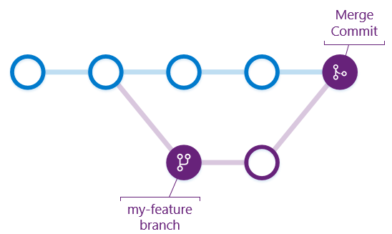
Protecting the master branch: Continuous Integration
CI happens here
Notes:
We will choose single trunk, but now we need to protect master from buggy code because master should always be deployable to production. We do that with continuous integration.
Note: in industry, most companies REQUIRE CI testing to pass completely before merging the feature branch into master.

Slide 24
Workshop
Let’s do our first contribution

Slide 25
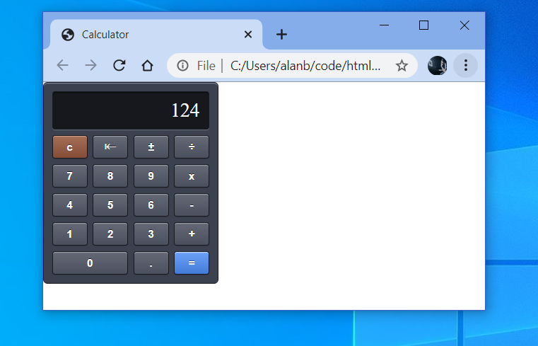
Run the project locally
You have the project cloned.
Make sure you are in the master branch.
Open Index.html
Notes:
We cloned the project earlier. (git clone command)
We cloned to a directory, move to that directory in your terminal using “cd” commands and then run “git status” to verify that we are in the master branch.
Open the Index.html file.

Slide 26
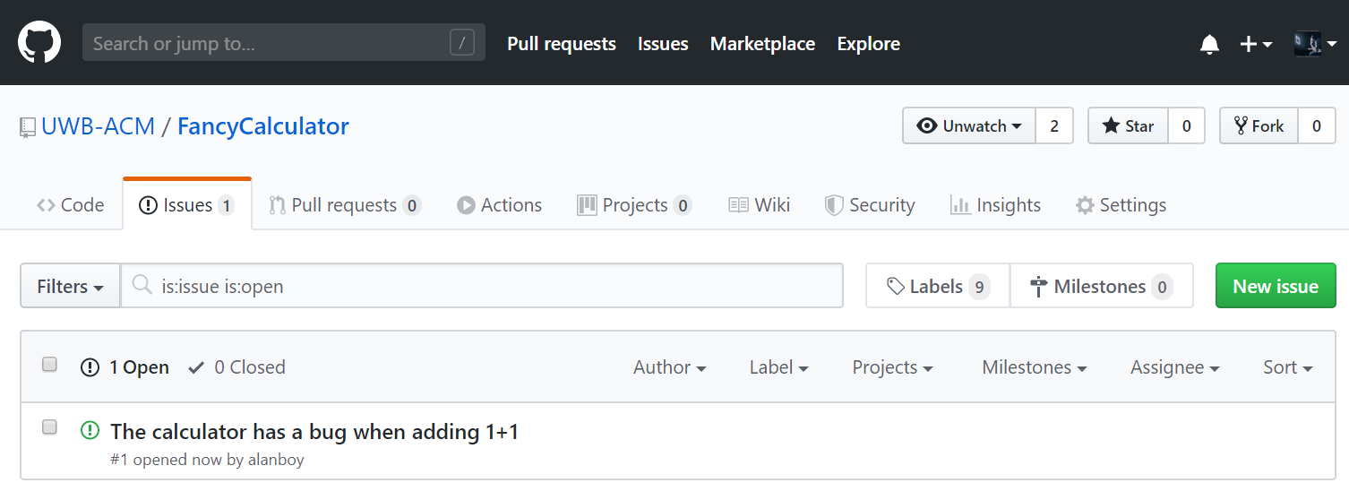
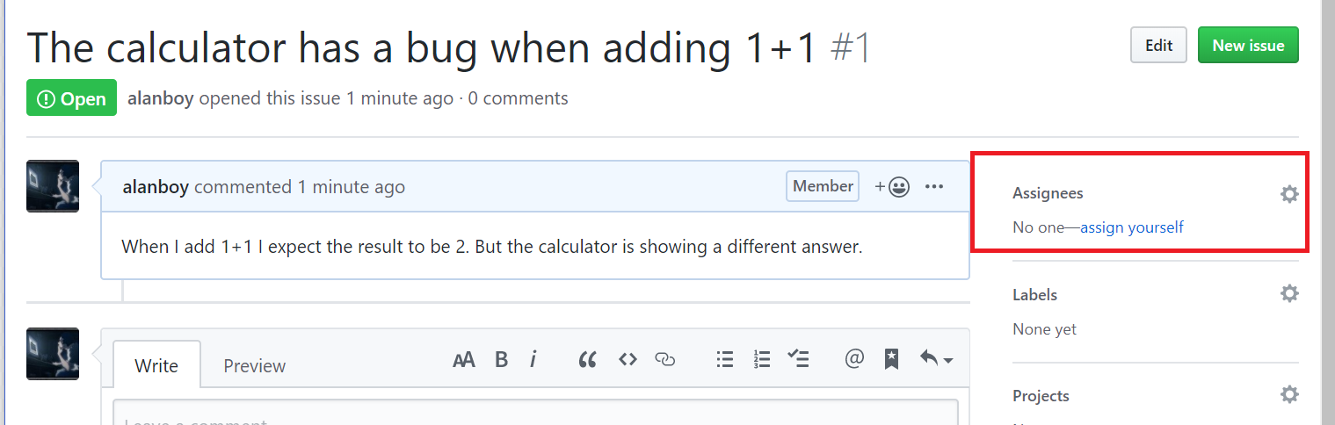
Pick a bug and create your topic branch
Go to https://github.com/UWB-ACM/FancyCalculator/issues
Look for a bug and assign it to yourself!
Create a new branch:
Notes:
Here I will create 20-30 bugs.
Commands in this slide:
git checkout -b fixing_addition

Slide 27
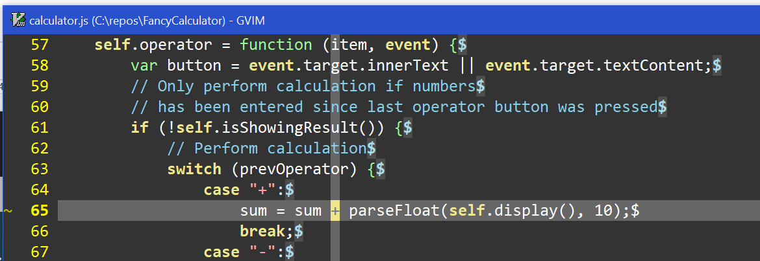
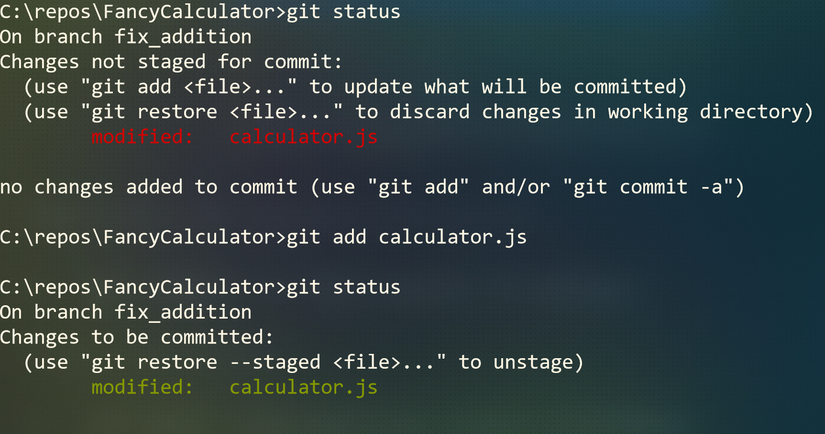
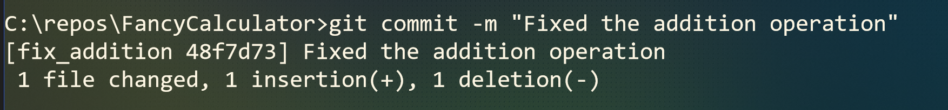
Push your changes to GitHub
Fix the bug:
The bug description has precise instructions on hot to fix the bug
Add to staging area and commit:
Your file is now modified. Add it to the staging area with `git add` and then commit your changes with `git commit`.
Push your branch
Your branch is known locally (in your PC) but we want the remote server to also know about it, so we do `git push --set-upstream origin <<name of branch>>` (see notes for more on this)
Notes:
Commands in this slide:
After you modify the files, add the files to the staging area:
`git add <file that you changed>`
Create a commit:
`git commit -m “<Describe your change here>”
Push your branch:
`git push`, you will get an error:
fatal: The current branch a_different_bug has no upstream branch.
To push the current branch and set the remote as upstream, use
git push --set-upstream origin a_different_bug
Copy paste the recommended command

Slide 28
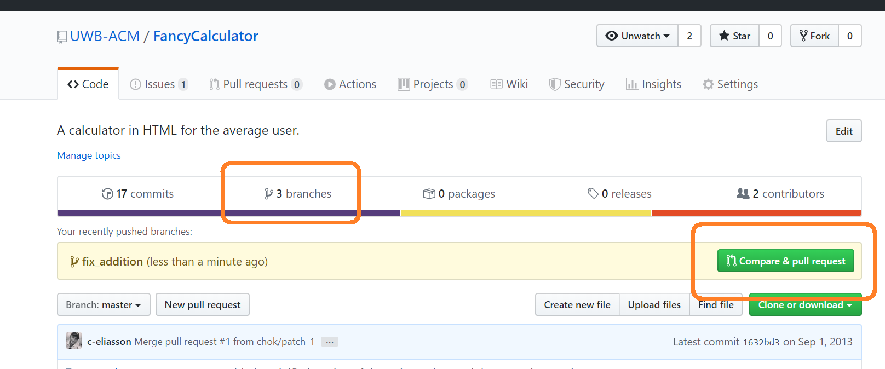
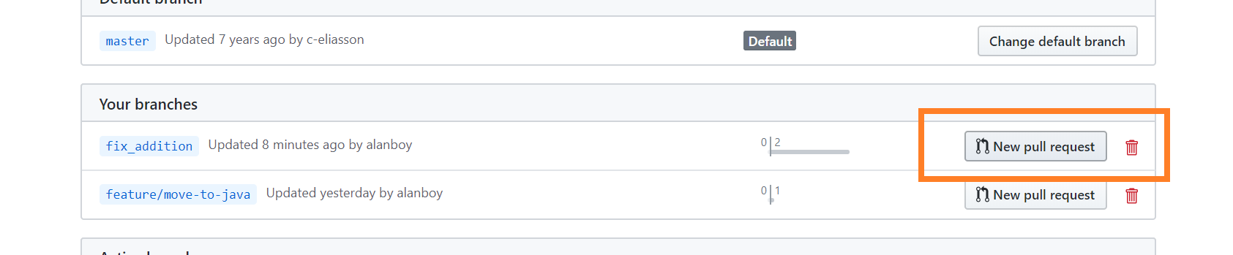
Find your branch and start a Pull Request
Go to https://github.com/UWB-ACM/FancyCalculator/branches
Find your branch and start a Pull Request
Notes:
Here I will create 20-30 bugs.

Slide 29
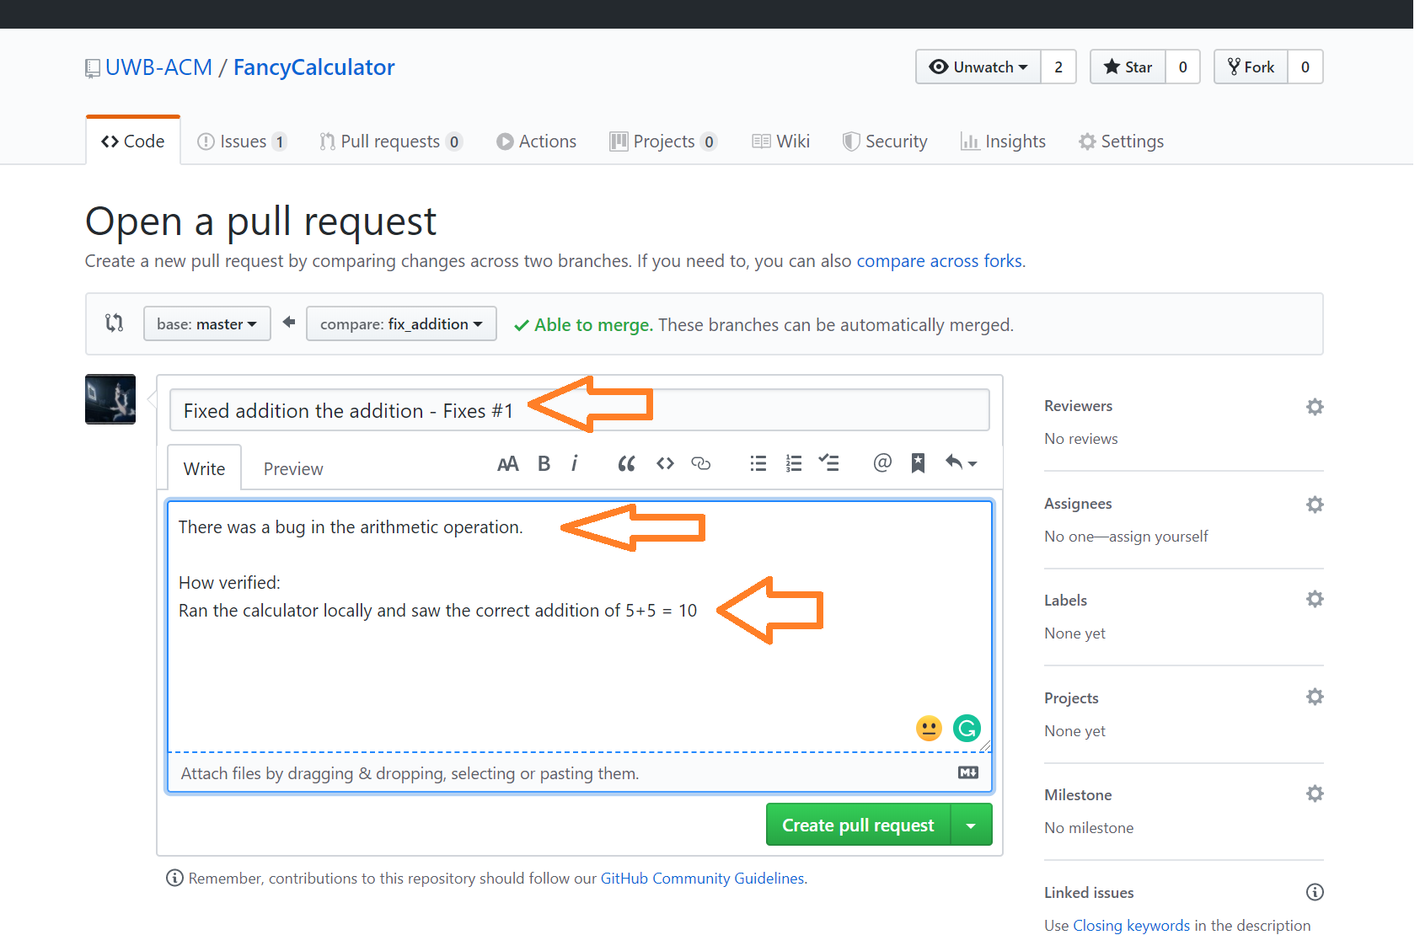
Add details to the Pull Request
Add a title. Include the text “Fixes #1” if you want to automatically close bug #1 when you complete this PR.
Add a description.
Add a how verified section so that reviewers know how you tested this code.

Slide 30
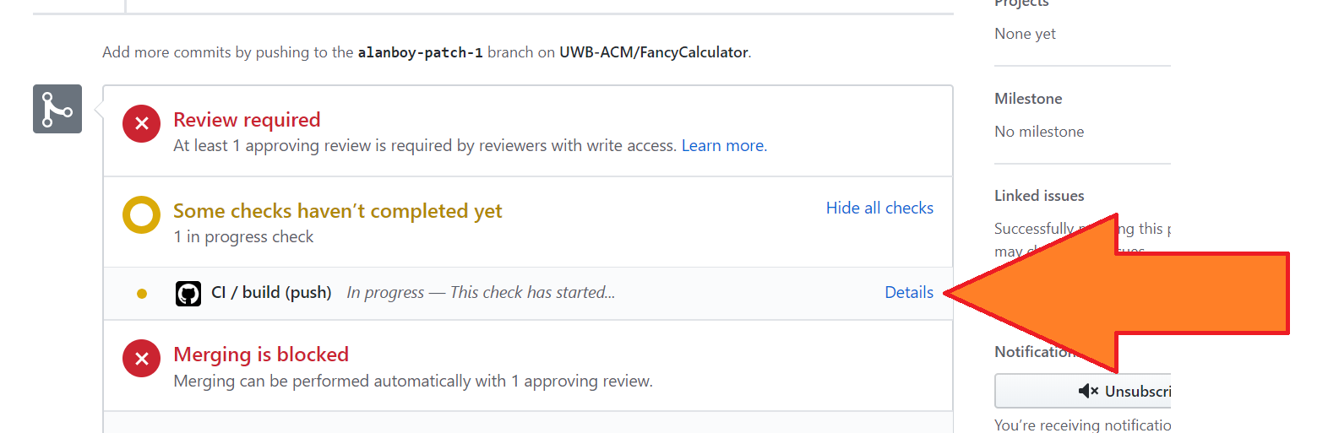
Check on your CI build
Continuous Integration will run some tests on your branch.
Our repo has two policies:
1 reviewer must approve
Must pass CI build

Slide 31
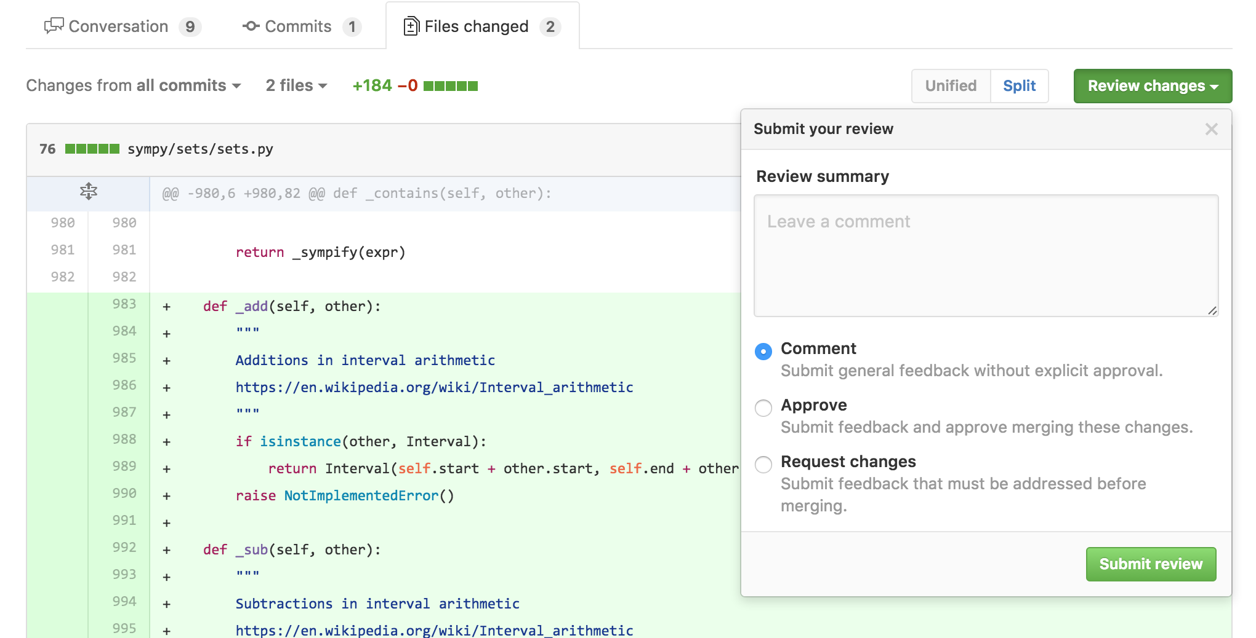
Complete someone else's PR
Review changes and approve the PR for someone else

Slide 32
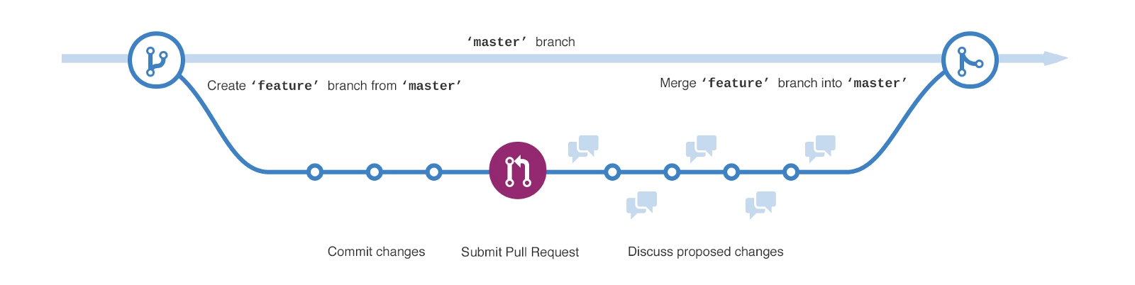
Your PR is completed: what happened?
Your PR was completed.
Your changes are now in master branch.
The issue should be closed.

Slide 33
Let’s try this again: pick a bug to fix
Go to https://github.com/UWB-ACM/FancyCalculator/issues
Look for a bug and assign it to yourself!
Notes:
Assign yourself a new bug.

Slide 34
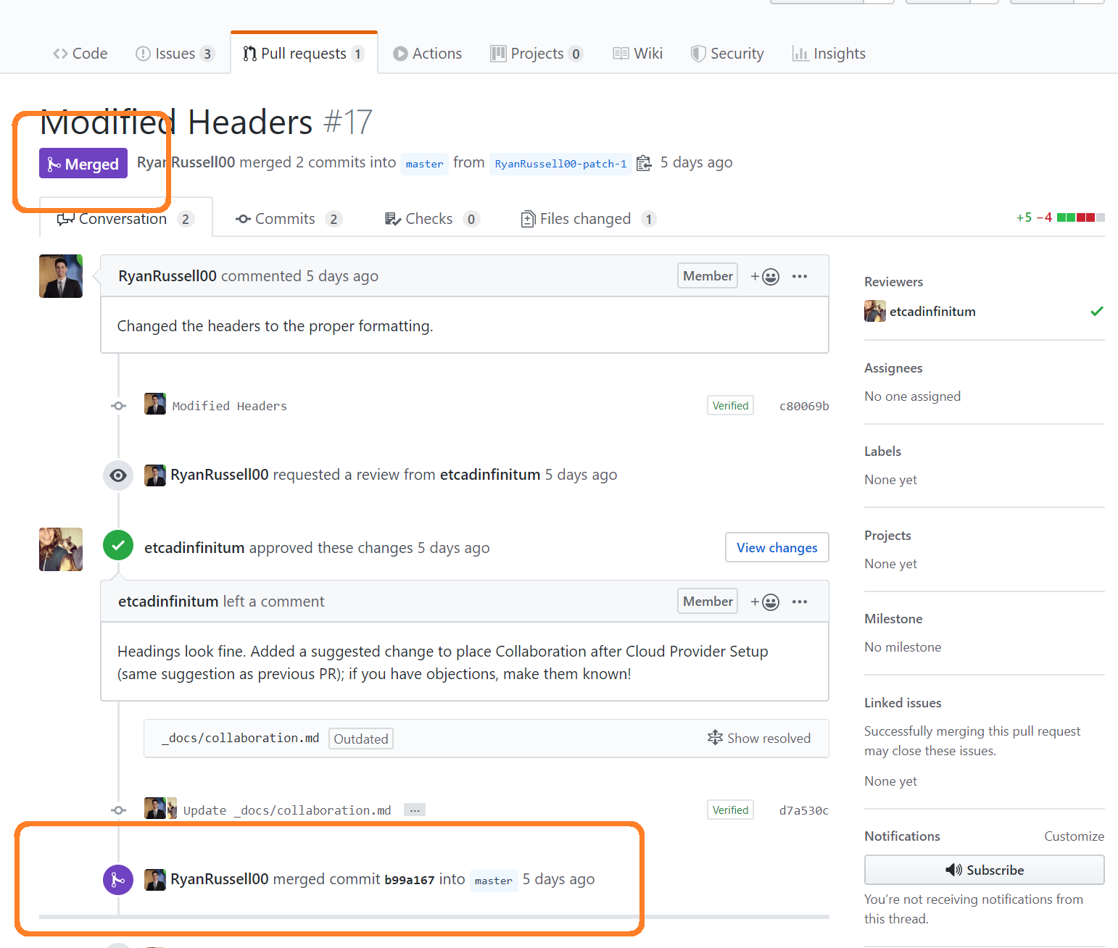
Make sure you create a new branch off master!
Your topic was merged in the remote repository (on GitHub), but your local repository does not know nothing about these changes, you need to PULL the changes.
Notes:
Assign yourself a new bug.

Slide 35
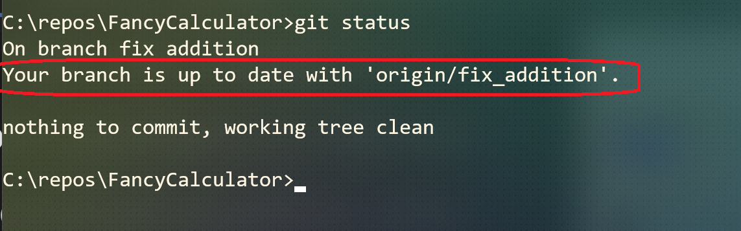
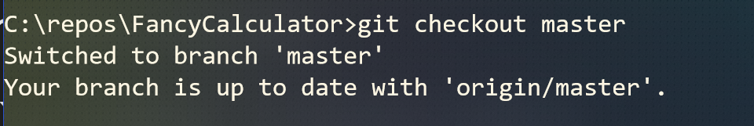
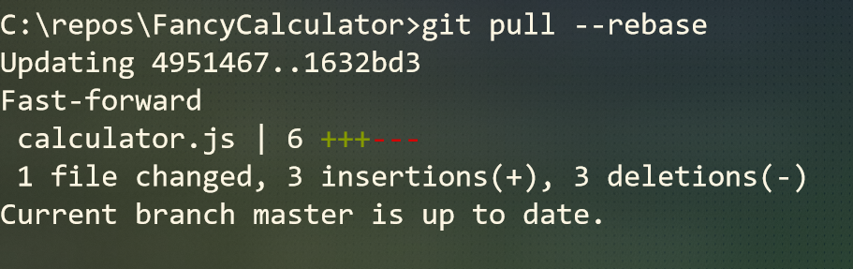
Make sure you create a new branch off master!
The PULL command works on the current branch, since we want to PULL master, let’s change branches.
Run `git status` to know which branch you are in.
If you are not in master, checkout master with `git checkout master`
Now you can `git pull --rebase`

Slide 36
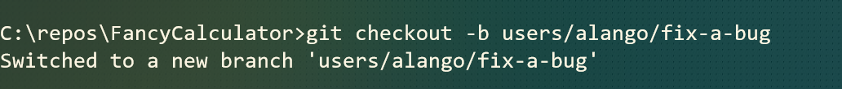
Now you can create your own branch off the new updated master
Now you can create your new branch
use branch naming structure: users/(your name)/fixbux)
And start working on your new bug (the instructions on what to do are in the bug description)
Make your code changes, but DON’T COMMIT anything yet.

Slide 37
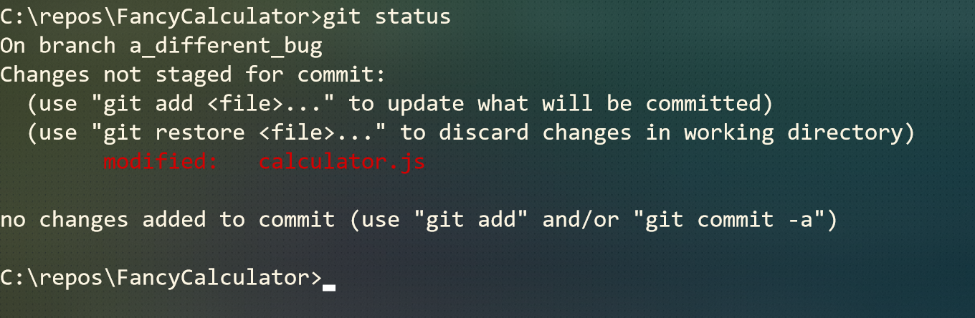
Show your changed files (not commited)
If you run git status now, it should look something like this:
Your changed files should NOT be staged for commits. If you accidentally committed just make a different change to the file.

Slide 38
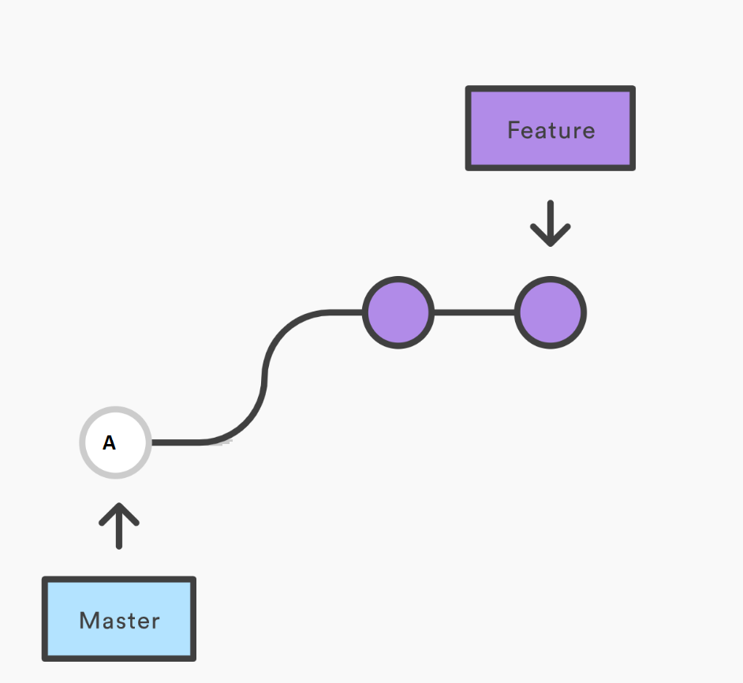
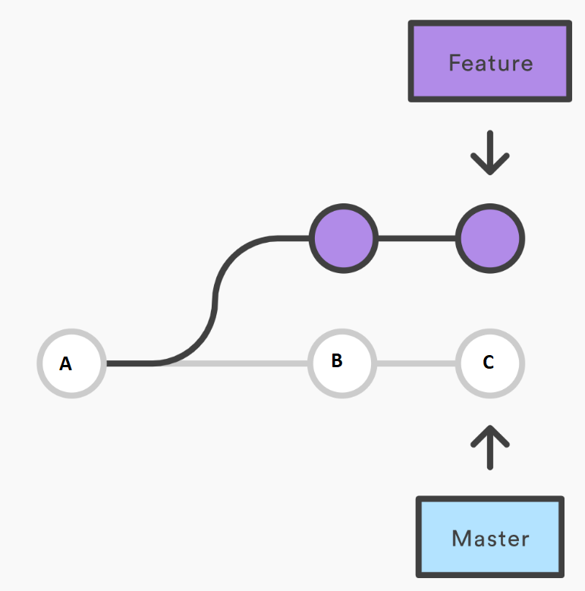
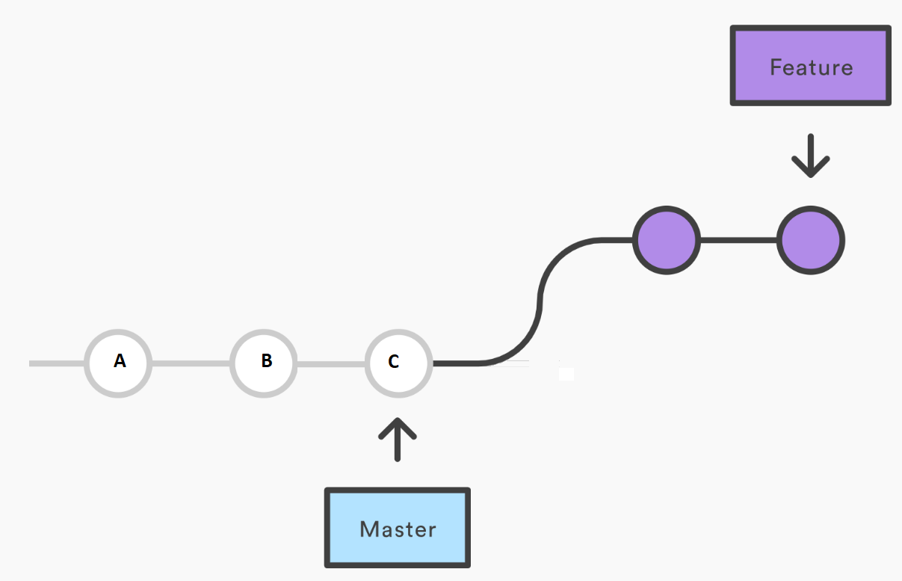
Master was updated!
This is how we started. We created a new branch off the master tip. And started adding commits (purple).
Then, master got two new commits (B and C). We want to bring these changes to our topic branch.
We rebased the branch, we are again starting off the master head.
You are on your way working on the feature branch and adding commits to your branch and that’s great… until...
a dev has updated the master branch by completing a PR. This means that you are now “behind”. You want to “update your feature branch”.

Slide 39
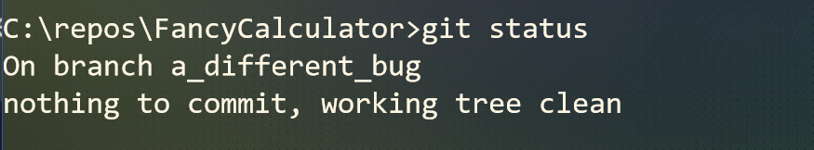
Saving your work: Stash
We want to catch up our branch, but we are in the middle of uncommitted work, for that we can use stash. The stash command saves your local modifications away and reverts the working directory to match the HEAD commit.
Run `git stash`
Now run `git status` to see the result of the stash:

Slide 40
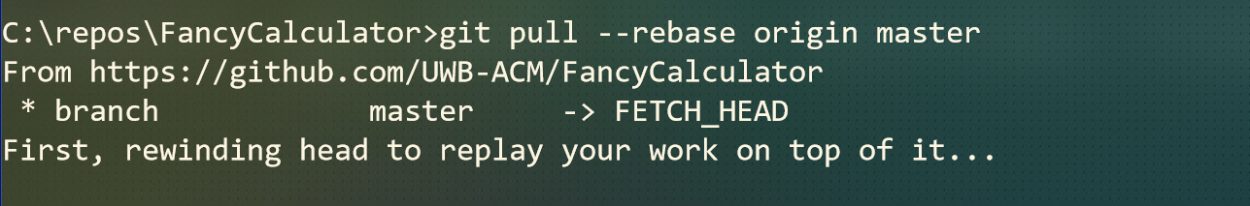
Let’s catch up with the remote master
Let’s “rebase” with `git pull --rebase origin master`

Slide 41
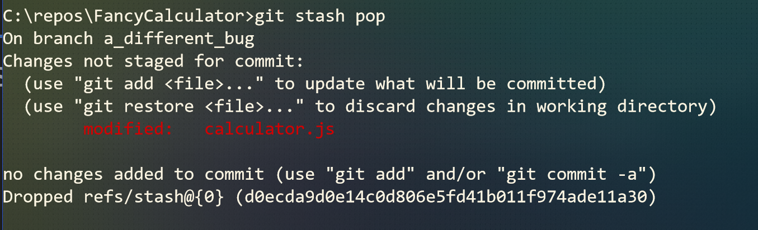
Don’t forget your stashed changes
The stash is a stack, so by stashing you have “pushed” a set of changes, and now you can “pop” them back into your working area:

Slide 42
You are back on track, now create and complete the PR
Create the PR, add the title, description and how verified section.
Get someone to review
Wait for continuous integration
Complete the PR

Slide 43
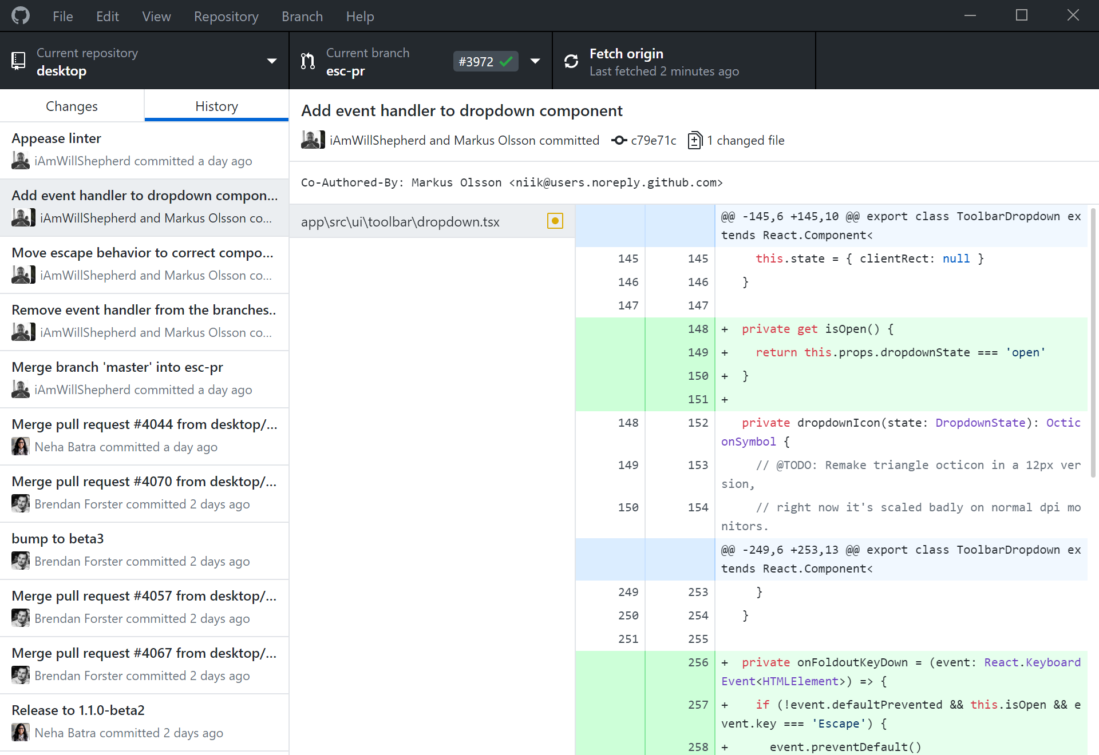
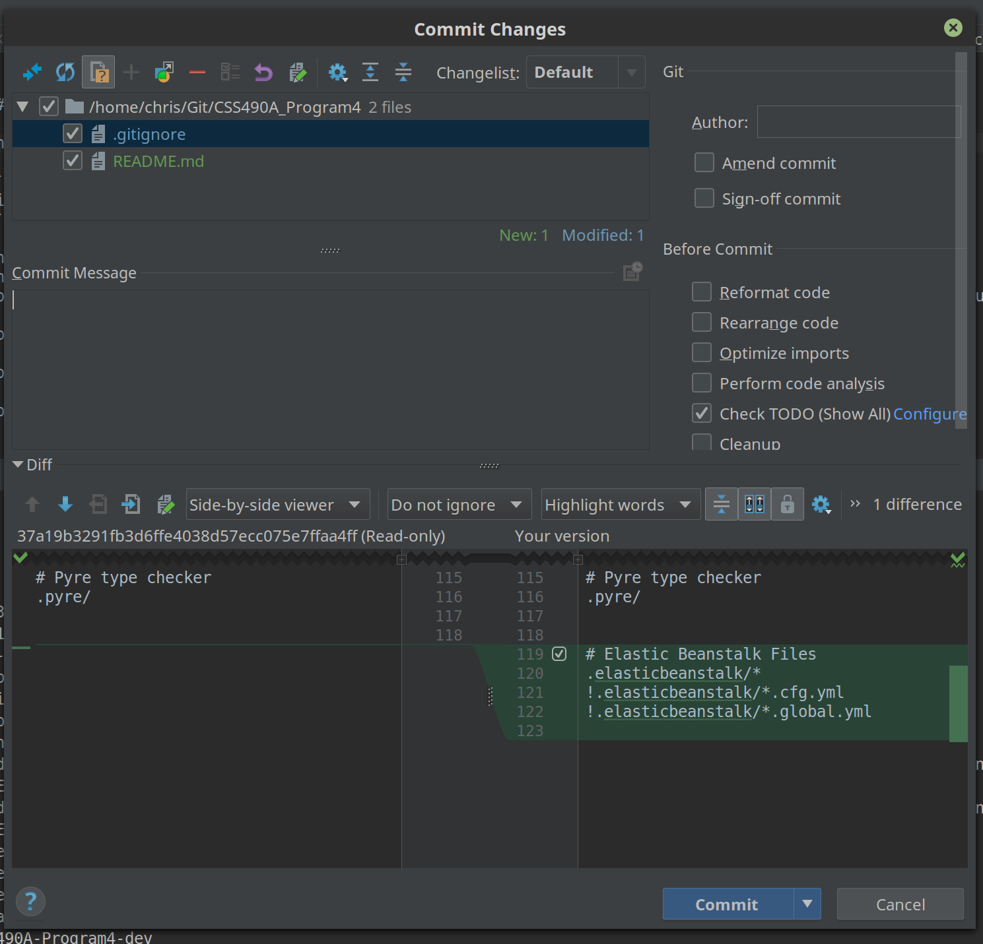
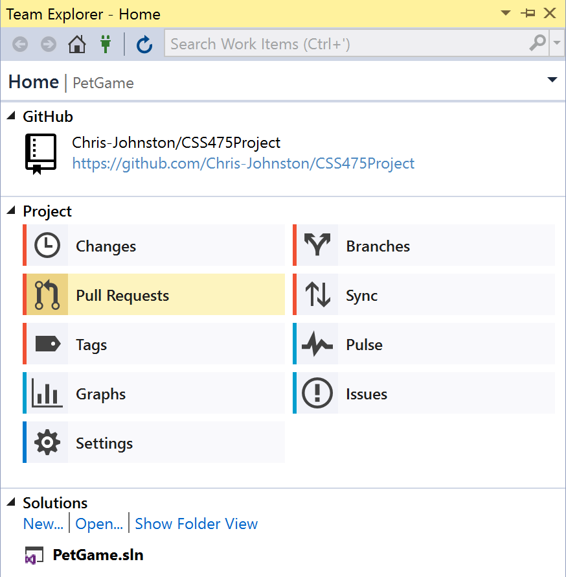
Git GUIs
Nearly every modern IDE will have a Git plugin (so does vim)
GitHub Desktop is a Git client that is oriented around GitHub. It works with non-GitHub repos too.
The JetBrains IDEs (IntelliJ, PyCharm, CLion) have pretty good Git integration.
Visual Studio has a pretty solid Git integration.

Slide 44
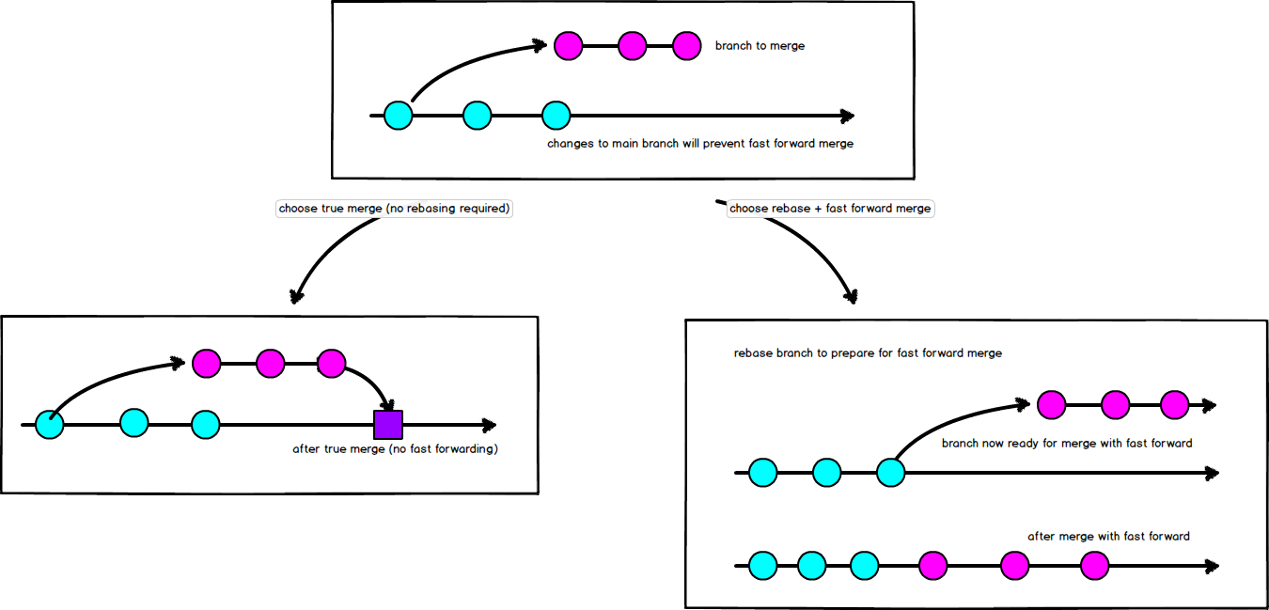
Merge vs Rebase
Notes:
https://hackernoon.com/git-merge-vs-rebase-whats-the-diff-76413c117333
This is just a reference slide when someone inevitably asks about merging vs rebasing.

Slide 45
Further Topics
*GitHub Issues
*Markdown & making a good readme
*Continuous Integration & Continuous Deployment: GitHub Actions, TravisCI, Jenkins, CircleCI
Releases / tags
Licensing
In-Depth Merging
Interactive Rebasing
Forking a repo
Gitignore
Gitattributes
hooks
If you have questions right now, we can try to give a brief explanation.
We encourage you to learn these on your own! Practice! Try using Git for your programming assignments.

Slide 46
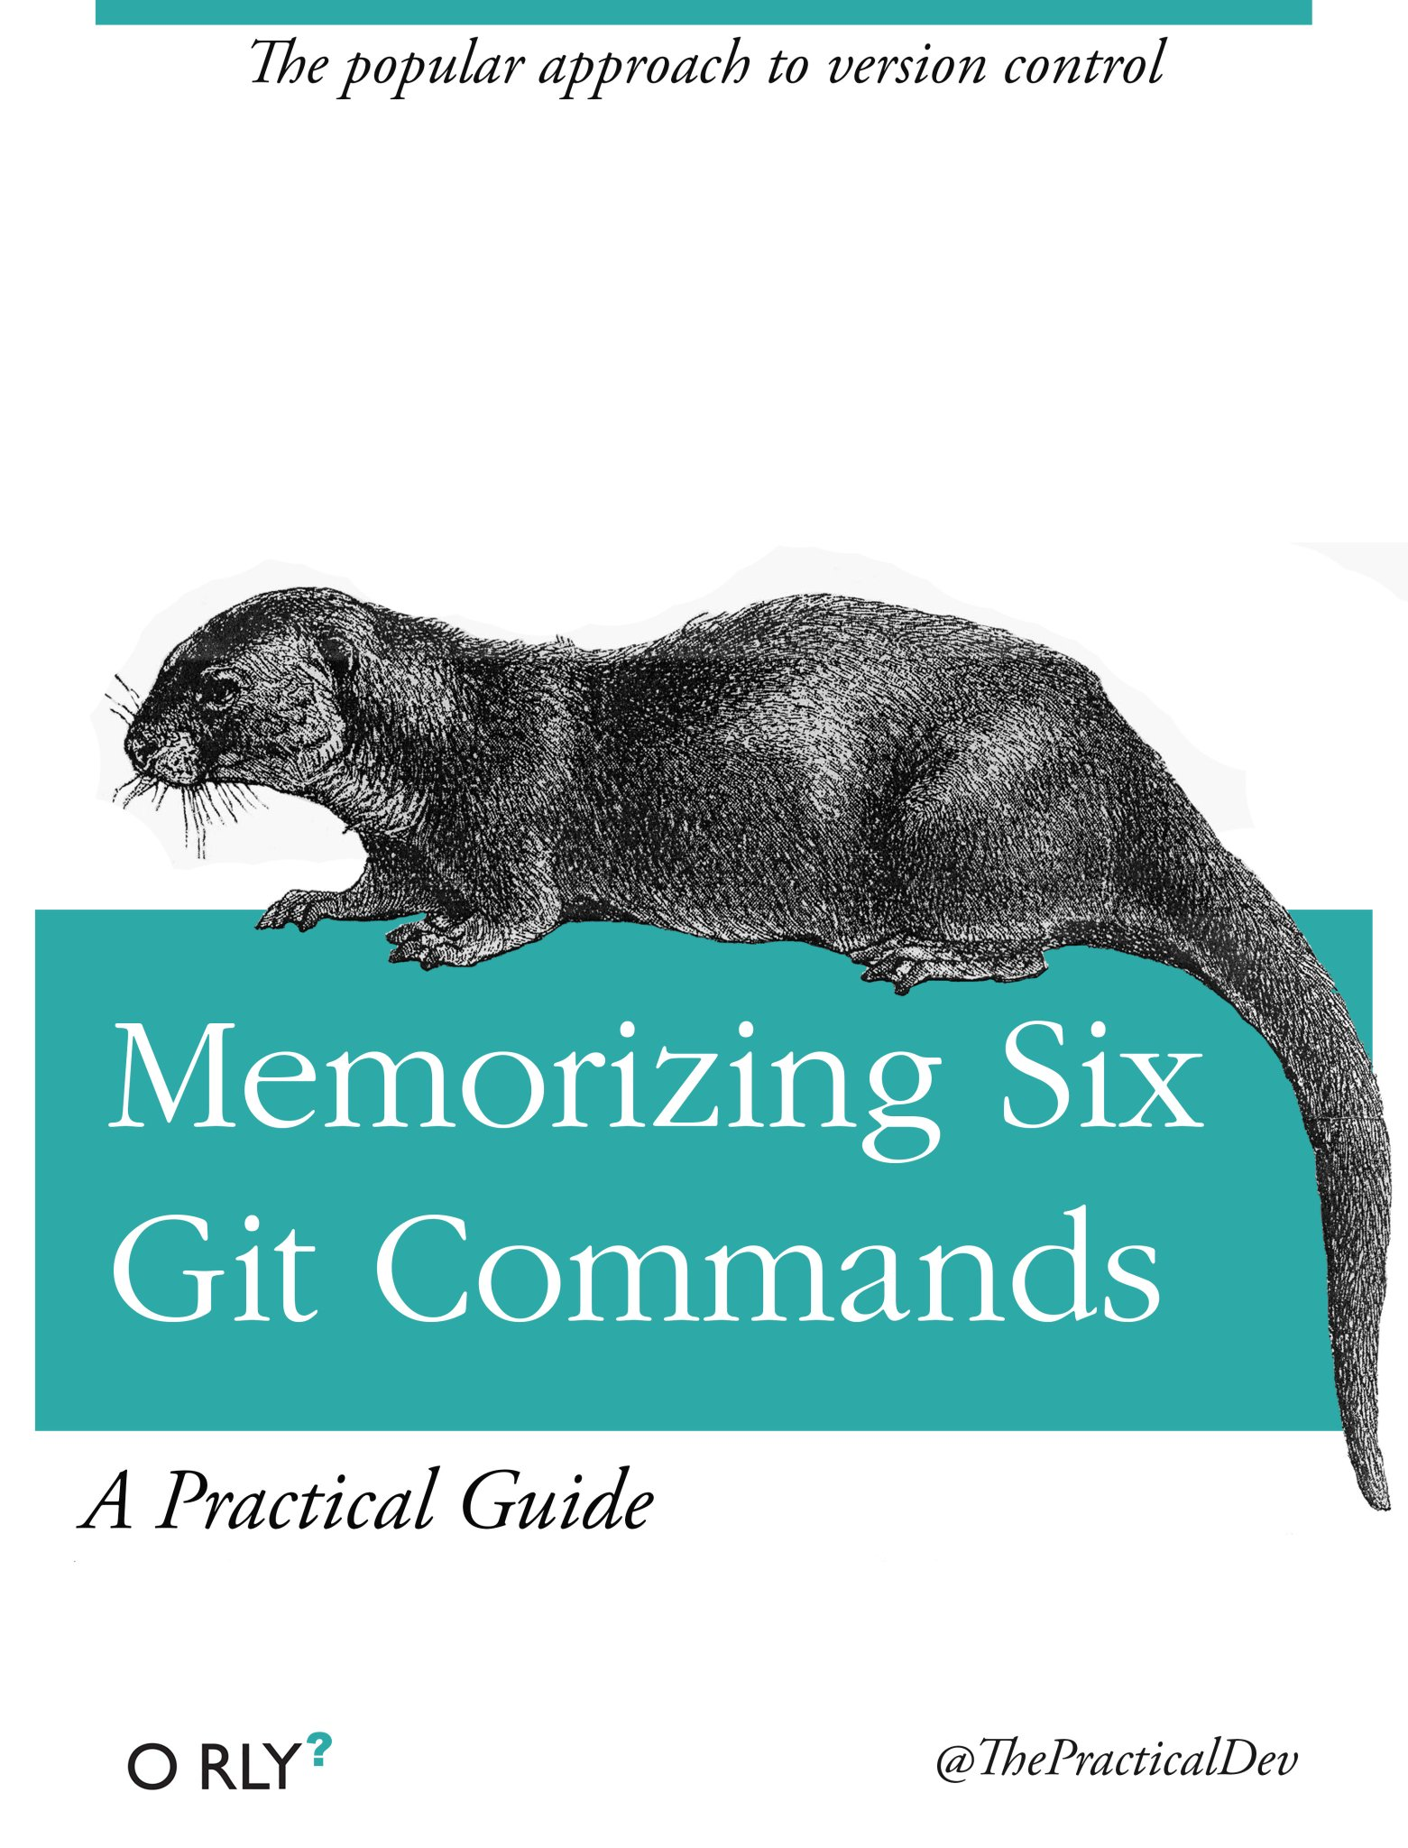
Great Resources for Further Reading
The official Git documentation: https://git-scm.com/doc
GitHub documentation: https://guides.github.com/
Atlassian Git tutorials: https://www.atlassian.com/git/tutorials
And of course: Google, Stack Overflow, and your peers!

Slide 47
Questions?
Comments?
Concerns?
Anything from the previous
slides or b e y o n d?

